Slide 1
Lesson 4 Lecture 2: Odometry data for a TurtleBot in the Gazebo simulator using service
Intelligent Mobile Robotics
Dr. Aboozar Taherkhani (PhD)
email: aboozar.taherkhani@dmu.ac.uk

Slide 2
Content
Launch Gazebo to simulate ‘Turtlebot 3’ in a ‘Warehouse’ environment
ROS Messages
Ros Launch files
ROS packages
Launch files
Notes:
http://gazebosim.org/tutorials?cat=guided_b&tut=guided_b1

Slide 3
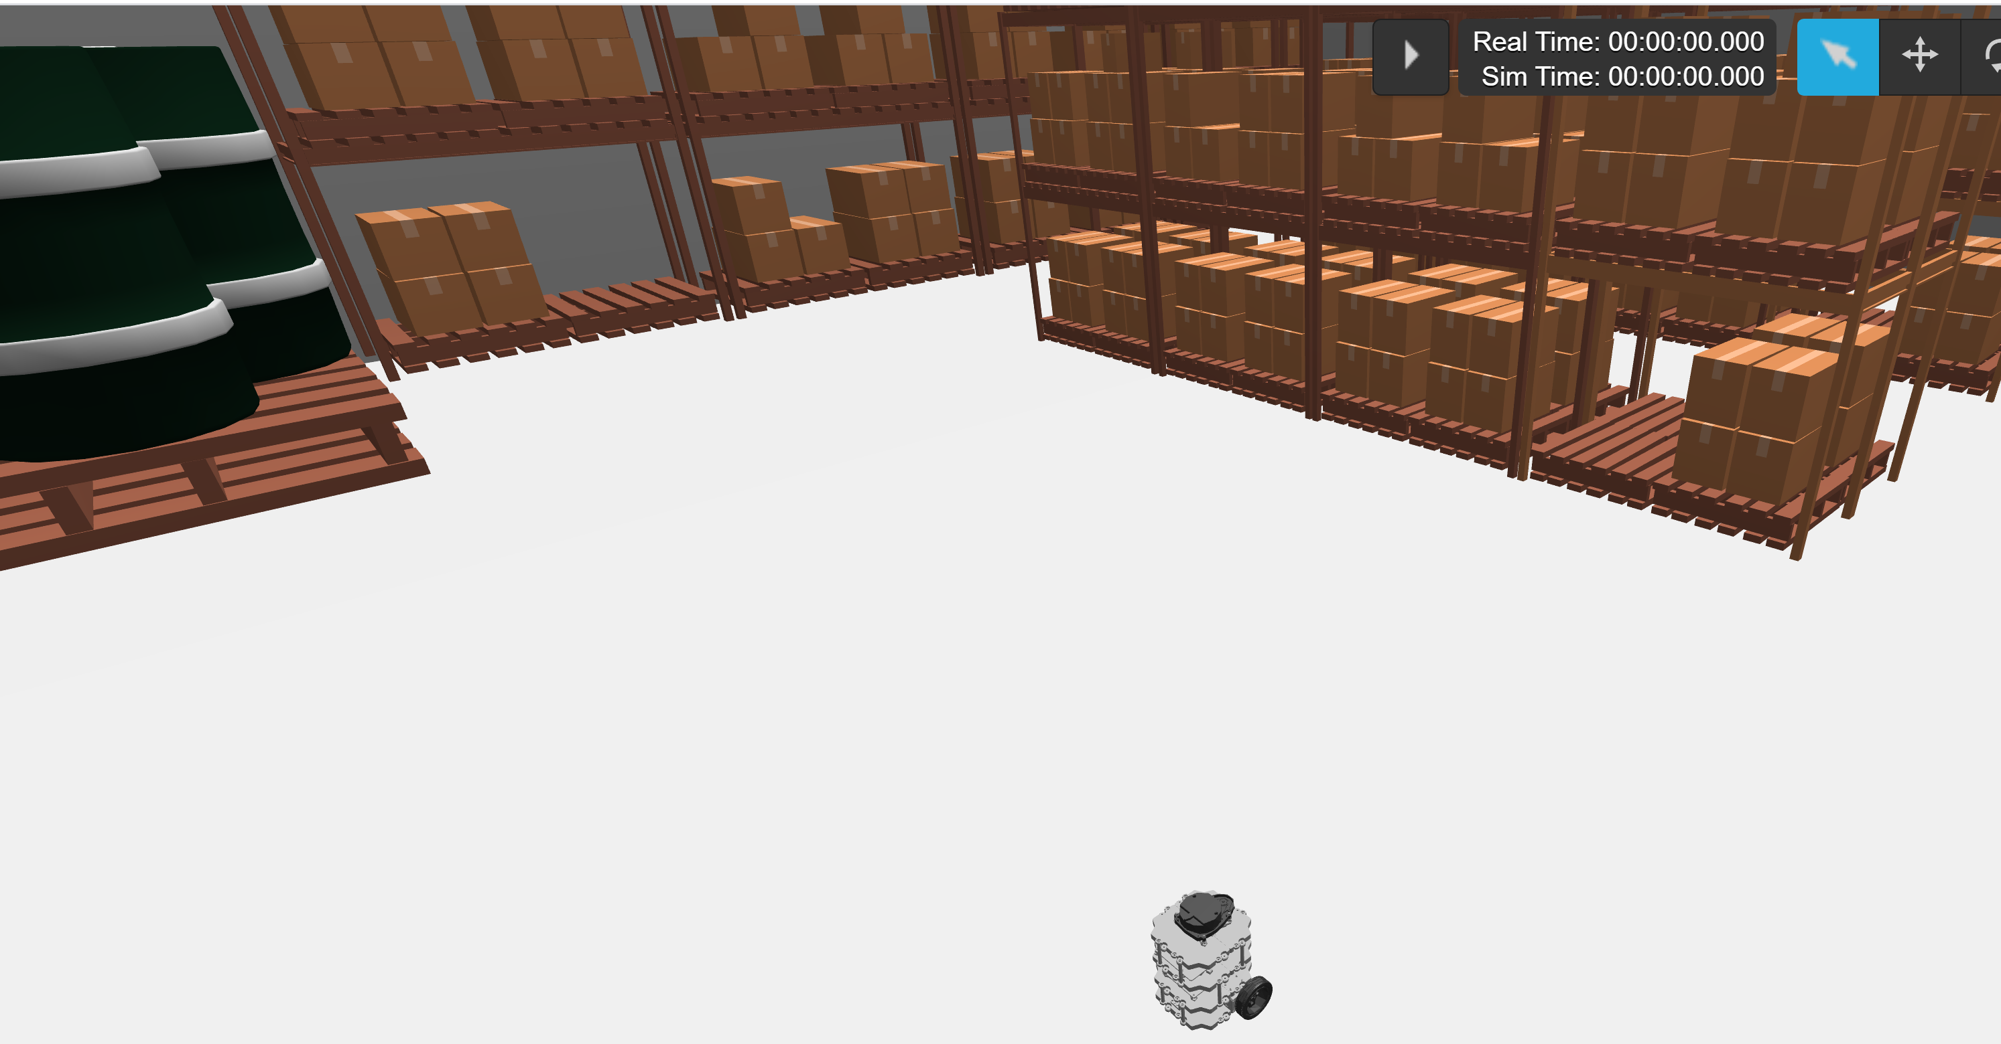
Gazebo (Recap)
Gazebo is a popular 3D dynamic simulator with the ability to accurately simulate robots in complex environments
Gazebo can be used in any stage of robot development, from testing algorithms to running regression testing in realistic scenarios
http://gazebosim.org/tutorials?cat=guided_b&tut=guided_b1
Notes:
http://gazebosim.org/tutorials?cat=guided_b&tut=guided_b1

Slide 4
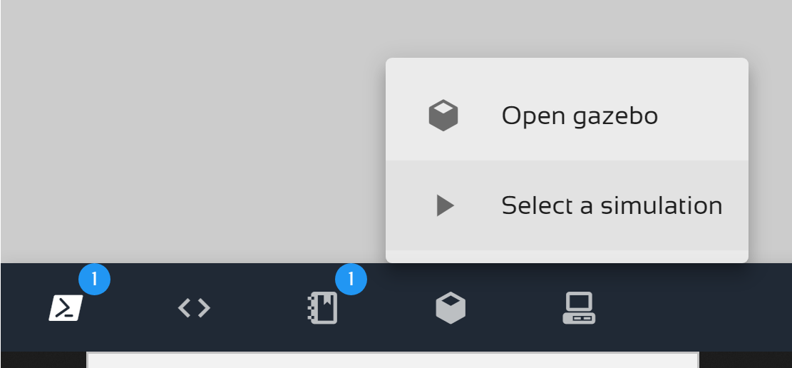
Gazebo
Using ROS Development Studio to open the Gazebo and select a simulation.
select ‘Turtlebot3’ bot and ‘Warehouse’ to be simulated.
http://gazebosim.org/tutorials?cat=guided_b&tut=guided_b1
Notes:
http://gazebosim.org/tutorials?cat=guided_b&tut=guided_b1

Slide 5
Gazebo
http://gazebosim.org/tutorials?cat=guided_b&tut=guided_b1
Notes:
http://gazebosim.org/tutorials?cat=guided_b&tut=guided_b1

Slide 6
Nodes can publish and subscribe (Recap)
Subscribs
Topic
Node 2
Publishes
Node 1
Message
Message
Message
Node 3
Subscribss
The publish / subscribe model is a very flexible communication paradigm
Notes:
http://wiki.ros.org/Services

Slide 7
ROS Messages (Recap)
Nodes communicate with each other by publishing simple data structures to topics. These data structures are called messages
A message is defined by field types and field names:
int32 x
More complex field types can also be defined for specific application
A sensor packet node publishes sensor data as an array of a user-defined SensorData object
This message could have the following fields:
time stamp
SensorData[] sensors
uint32 length
In this case SensorData is a user-defined field type and the empty bracket [] is appended to indicate that field is an array of SensorType objects
Notes:
where int32 is the eld type and x/y is the eld name.

Slide 8
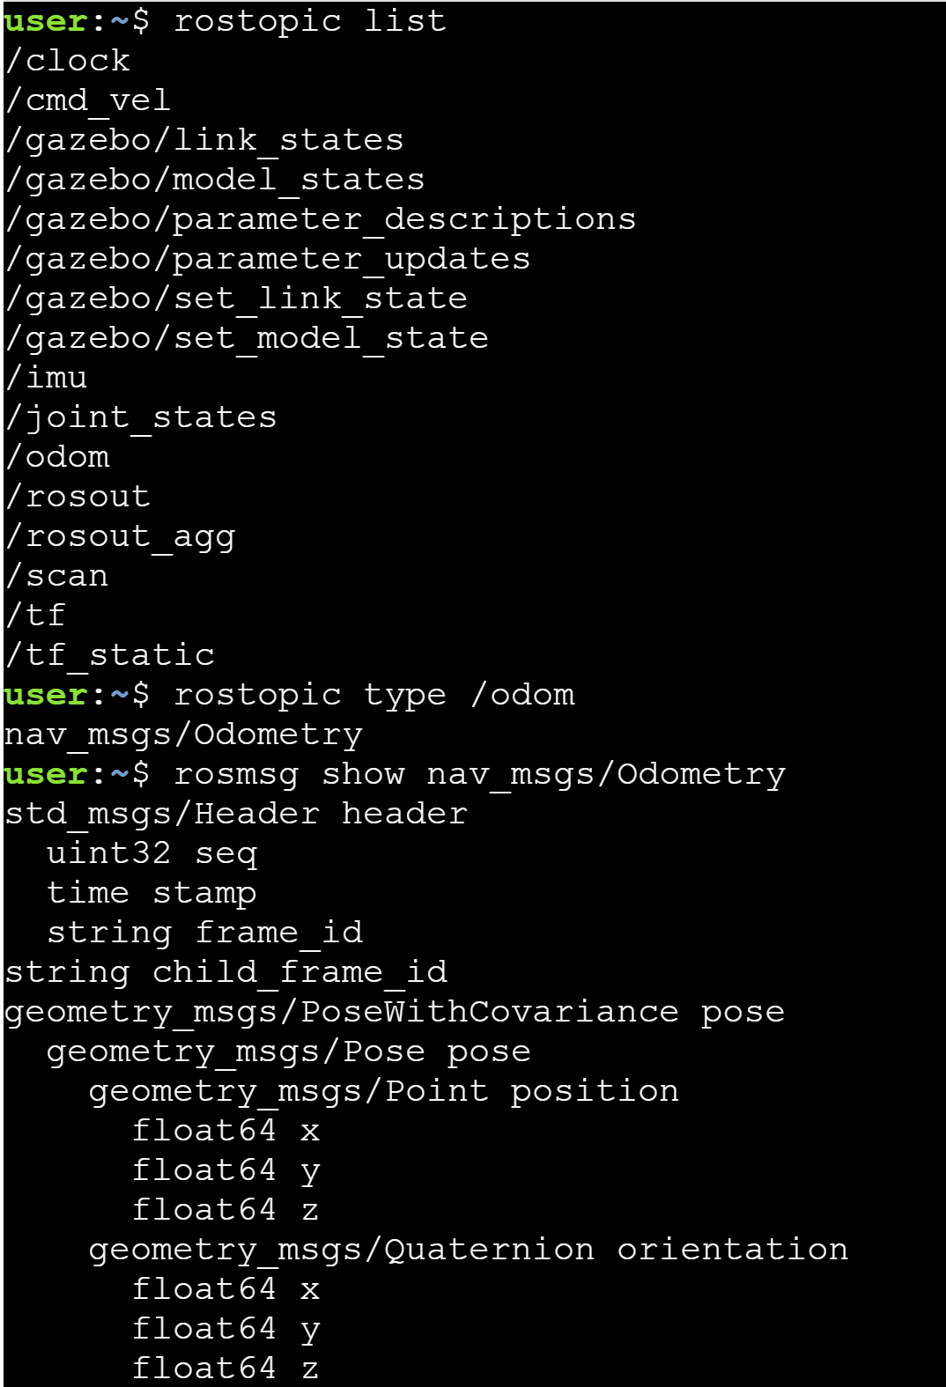
Nodes send and receive messages
Notes:
This will give the odometry data of the robot in the Gazebo simulation

Slide 9
ROS packages (Recap)
The ROS software is divided into packages that can contain various types of programs, images, data, and even tutorials
The specific contents depend on the application for the package
A package can contain programs written in Python or C++ to control a robot or another device
Can contain code for multiple nodes
A ROS package could be launched by .launch file

Slide 10
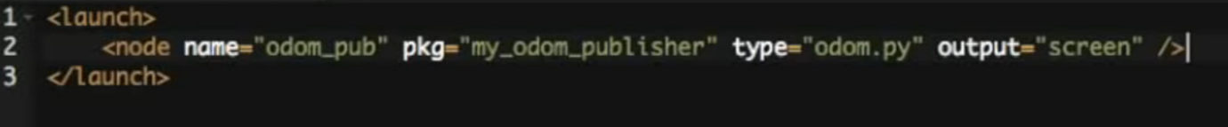
Ros Launch files
Launch files are .launch files with a specific XML format that can be placed anywhere within a package directory to initialize multiple nodes, configuration files, and a master
launch tags:
<launch> ... </launch>
To start a node using a launch file :
<node name="..." pkg="..." type="..."/>
pkg points to the package associated with the node that is to be launched
type refers to the name of the node executable file
output= "screen" : show output on the screen
ROS Development Studio
Notes:
As a robot project grows in scale, the number of nodes and configuration files grow very quickly. In practice, it could be very cumbersome to manually start up each individual node. A launch file provides a convenient way to start up multiple nodes and a master, as well as set up other configurations, all at the same time.

Slide 11
ROS Launch Files
Simple XML files that allow you to
Launch multiple nodes at once
Set parameters for those nodes
Start Master
roslaunch <package> <file>.launch

Slide 12
Getting help
ROS wiki (http://wiki.ros.org/)
Github
Stack Overflow
The Construct / Robot Ignite Academy
Google

Slide 13
Summary
Launch Gazebo to simulate ‘Turtlebot 3’
Nodes send and receives messages
ROS Messages
ROS packages
Launch files
roslaunch <package> <file>.launch

Slide 14
Reference
[1] Writing a Simple Publisher and Subscriber (Python)
http://wiki.ros.org/ROS/Tutorials/WritingPublisherSubscriber%28python%29
[2] Creating a ROS Package
http://wiki.ros.org/ROS/Tutorials/CreatingPackage
[3] ROS Robotics By Example
By Carol Fairchild, Dr. Thomas L. Harman
The pdf of the book is available on DMU library:
https://dmu.summon.serialssolutions.com/?s.q=ROS+Robotics+By+Example&s.cmd=#!/search?ho=t&l=en-UK&q=ROS%20by%20example
[4] How to publish odometry from simulation position
https://www.youtube.com/watch?v=I_5leJK8vhQ
[5] Quaternions and 3d rotation, explained interactively
https://www.youtube.com/watch?v=zjMuIxRvygQ

